Slide 1
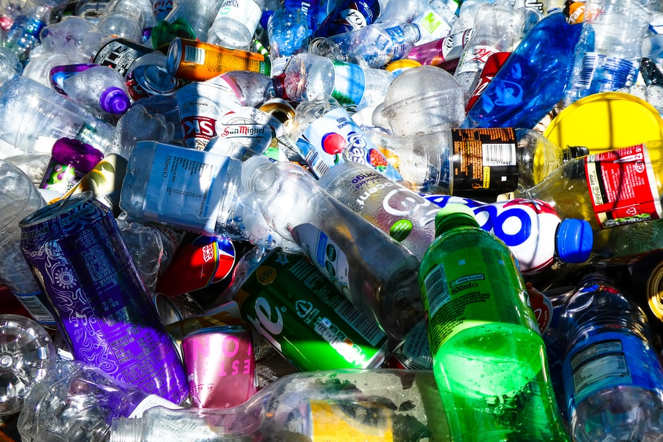
SOCIAL ANALYSIS TRIANGLE MODEL
GNED 500
WEEK 7
Photo by Nick Fewings on Unsplash

Slide 2
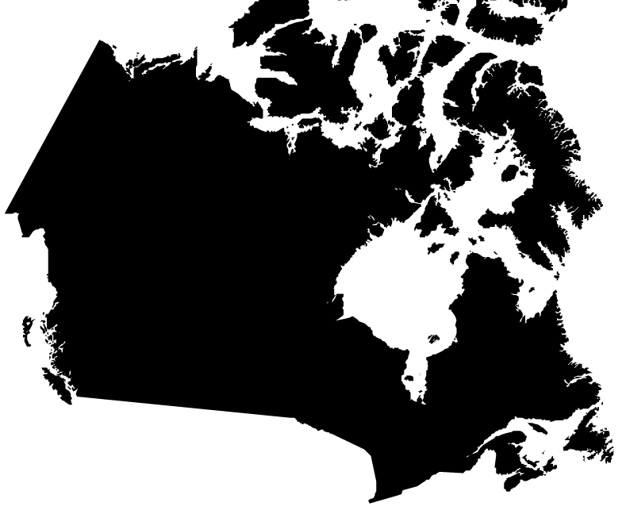
Acknowledgement
Traditional Lands
Canada Map Vectors by Vecteezy
Notes:
Acknowledgement of Traditional Lands
Centennial is proud to be a part of a rich history of education in this province and in this city.
We acknowledge that we are on the treaty lands and territory of the Mississauga’s of the Credit First Nation and pay tribute to their legacy and the legacy of all First Peoples of Canada, as we strengthen ties with the communities we serve and build the future through learning and through our graduates.
Today the traditional meeting place of Toronto is still home to many Indigenous People from across Turtle Island and we are grateful to have the opportunity to work in the communities that have grown in the treaty lands of the Mississauga’s.
We acknowledge that we are all treaty people and accept our responsibility to honor all our relations

Slide 3

AGENDA
Learning Outcomes
Social Analysis – Triangle Model
The Perennial Problem of plastic
The Story of Plastic
The Great Pacific Garbage Patch
Canada Bans Single Use Plastics
What can be done?
The Problem of Plastic
Historical Context(s)
Individual & Community Perceptions
Dominant Ideologies & Discourses
Institutional Perpetuations
Breakout Session
Social Action About Plastics
Questions
Check 3d by d3images - freepik.com
Notes:
Learning Outcomes
Review: Social Analysis – Triangle Model
The Perennial Problem of plastic
The Story of Plastic
The Great Pacific Garbage Patch
Canada Bans Single Use Plastics
What can be done?
Historical Context(s)
Individual & Community Perceptions
Dominant Ideologies & Discourses
Institutional Perpetuations
Breakout Session
Social Action: An Example
Questions

Slide 4

LEARNING OUTCOMES
At the end of this session, you will be able to:
Explain the triangle model of social analysis
Define key social analysis concepts used in this social analysis model
Apply the triangle model to examine a social problem
Understand how social analysis is linked to social change
LEARNING
OUTCOMES
Vector by pch.vector - freepik.com
Notes:
At its most basic level, Global Citizenship is the idea that we belong to a shared community of human beings.
This means that we think of ourselves not strictly as citizens of a particular nation, but as citizens of the whole world.
To understand the concept of global citizenship we need to begin with its foundations
First we need to consider: what is a citizen?

Slide 5
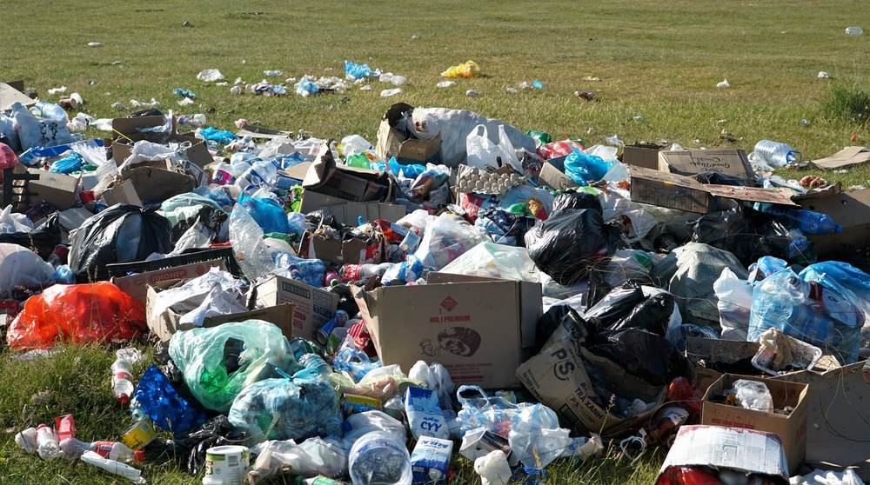
SOCIAL ANALYSIS TRIANGLE MODEL
Photo by Ariungoo Batzorig on Unsplash
Notes:
15 Minute Break

Slide 6
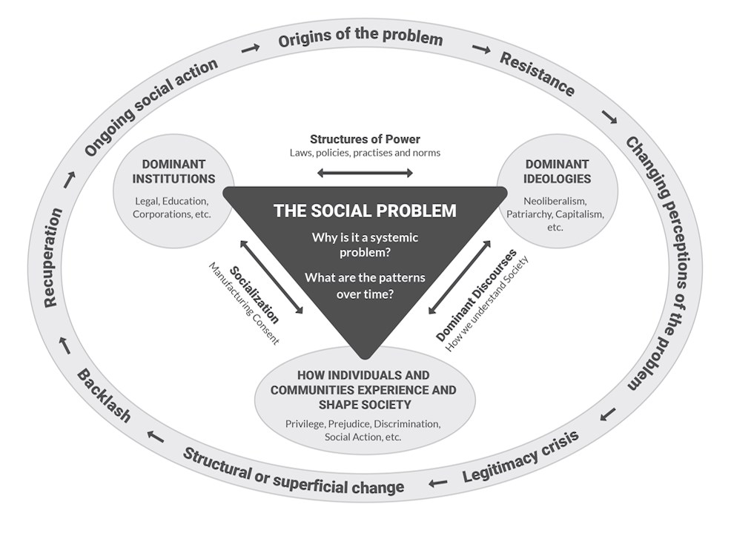
SOCIAL ANALYSIS – TRIANGLE MODEL
In the end, thinking critically about ourselves can help us engage in and see the usefulness of a social analysis of a social problem.
Now, we need to look at how to do a social analysis using a specific model.
We will use the triangle model.
“The Triangle Model of Social Analysis” by Chet Singh, Centennial College is licensed under a CC BY-NC-SA 4.0 International License.
Notes:
In the end, thinking critically about ourselves can help us engage in and see the usefulness of a social analysis of a social problem.
Now, we need to look at how to do a social analysis using a specific model.
We will use the triangle model.

Slide 7
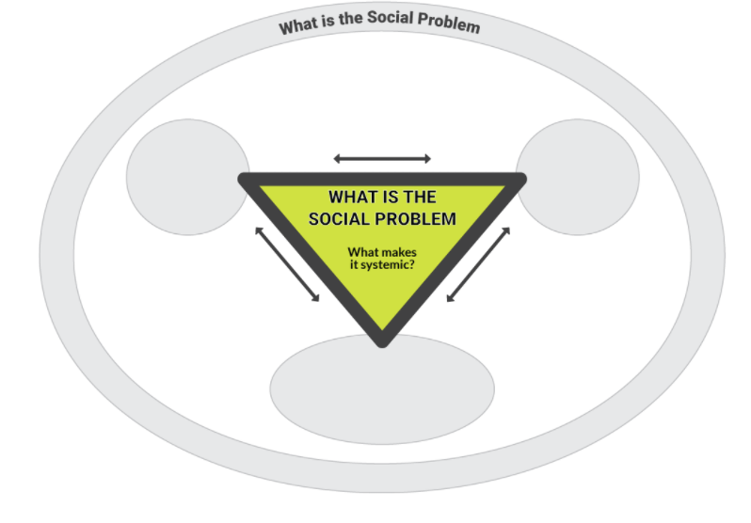
SOCIAL ANALYSIS
TRIANGLE MODEL OF SOCIAL ANALYSIS
“The Triangle Model of Social Analysis” by Chet Singh, Centennial College is licensed under a CC BY-NC-SA 4.0 International License.

Slide 8
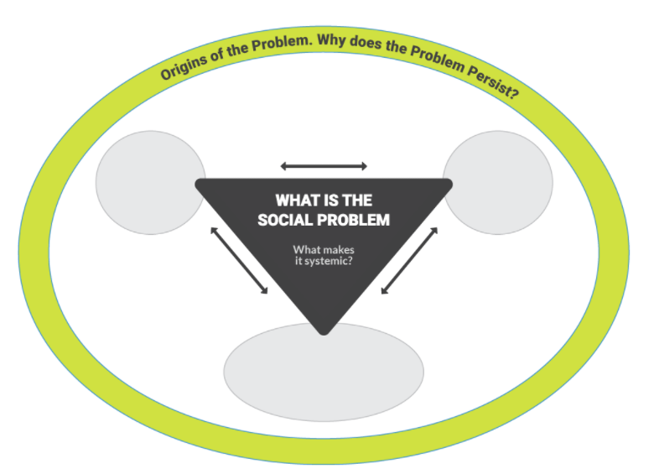
SOCIAL ANALYSIS
TRIANGLE MODEL OF SOCIAL ANALYSIS
“The Triangle Model of Social Analysis” by Chet Singh, Centennial College is licensed under a CC BY-NC-SA 4.0 International License.

Slide 9
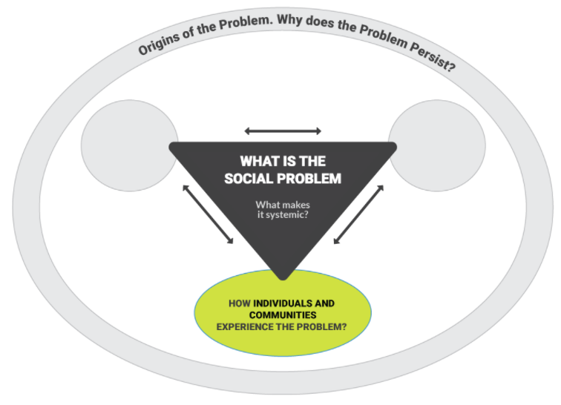
SOCIAL ANALYSIS
TRIANGLE MODEL OF SOCIAL ANALYSIS
“The Triangle Model of Social Analysis” by Chet Singh, Centennial College is licensed under a CC BY-NC-SA 4.0 International License.

Slide 10
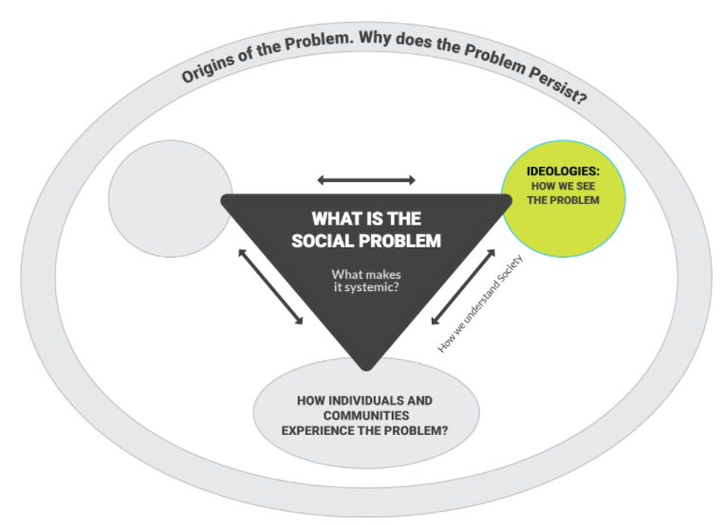
SOCIAL ANALYSIS
TRIANGLE MODEL OF SOCIAL ANALYSIS
“The Triangle Model of Social Analysis” by Chet Singh, Centennial College is licensed under a CC BY-NC-SA 4.0 International License.

Slide 11
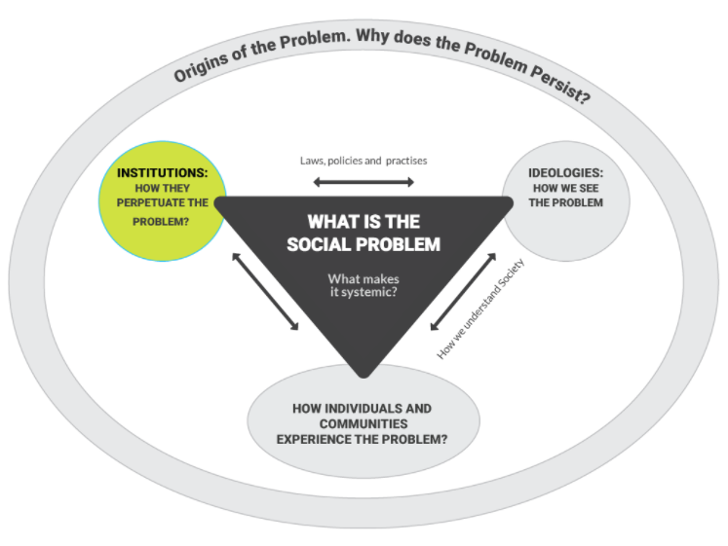
SOCIAL ANALYSIS
TRIANGLE MODEL OF SOCIAL ANALYSIS
“The Triangle Model of Social Analysis” by Chet Singh, Centennial College is licensed under a CC BY-NC-SA 4.0 International License.

Slide 12
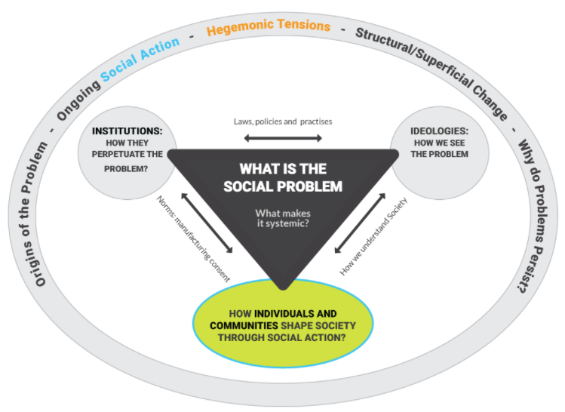
SOCIAL ANALYSIS
TRIANGLE MODEL OF SOCIAL ANALYSIS
“The Triangle Model of Social Analysis” by Chet Singh, Centennial College is licensed under a CC BY-NC-SA 4.0 International License.

Slide 13
SOCIAL ANALYSIS
TRIANGLE MODEL OF SOCIAL ANALYSIS
“The Triangle Model of Social Analysis” by Chet Singh, Centennial College is licensed under a CC BY-NC-SA 4.0 International License.
VIDEO
https://soaoer.centennialcollege.ca/gned500/wp-content/uploads/2021/06/TheTriangleModelofSocialAnalysis_3-1.mp4
Notes:
On one side are the ideologies that shape how we understand the problem.
The poor are lazy.
Women are less valuable than men.
The unemployed don’t really want a job.
On the other side are the social institutions that structure or maintain these beliefs.
The media
Education systems
The government
The economy
At the bottom of the triangle is the individual & Communities Experiences.
This is what we see, hear, or experience.
A woman losing her job.
A neighbour beating his wife.
A homeless man on the street.

Slide 14
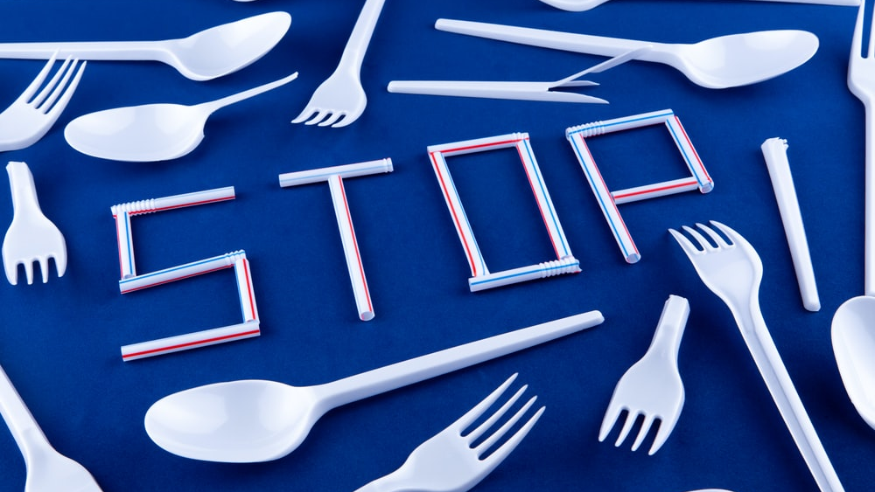
THE PERENNIAL PROBLEM OF PLASTIC!
Photo by Volodymyr Hryshchenko on Unsplash
Notes:
THE PERENNIAL PROBLEM OF PLASTIC!
What are the issues surrounding the problem?

Slide 15
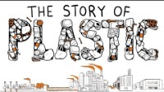
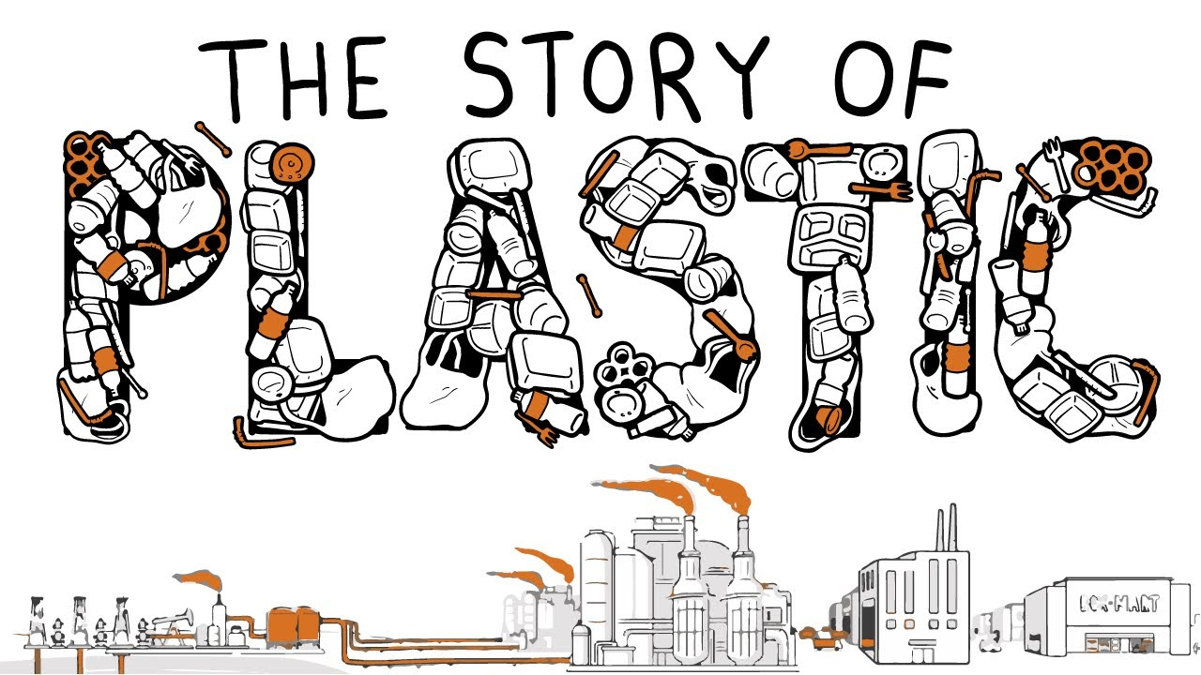
Notes:
The Story of Plastic
https://www.storyofstuff.org/movies/story-of-plastic-animation/
The Story of Plastic (animated short) pulls back the curtain on the plastic pollution headlines, revealing the true causes and consequences of the global plastics crisis. This animated short is a companion piece to The Story of Plastic (documentary), which premiered in April of 2020.
ANNOTATED SCRIPT
https://www.storyofstuff.org/wp-content/uploads/2021/04/SoSP.Movies.SOP_short.Script.pdf

Slide 16
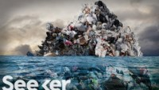
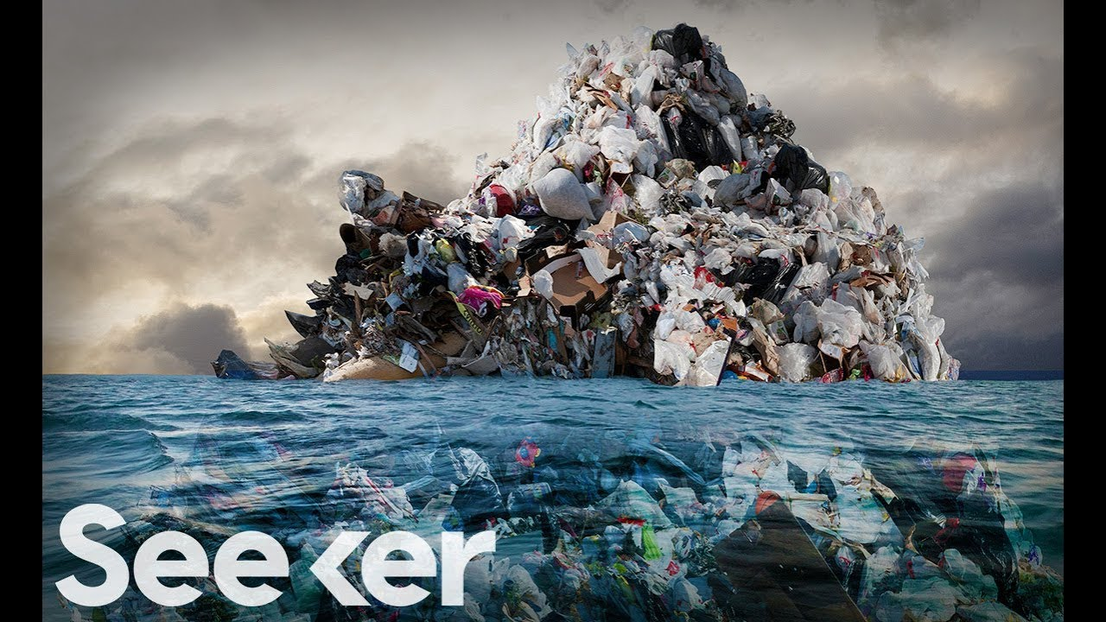
Notes:
The Great Pacific Garbage Patch Is Not What You Think It Is | The Swim
https://youtu.be/6HBtl4sHTqU

Slide 17
Canada banning plastic bags, straws,
cutlery and other single-use items
by the end of 2021
Photo by Volodymyr Hryshchenko on Unsplash
Notes:
https://www.ctvnews.ca/climate-and-environment/canada-banning-plastic-bags-straws-cutlery-and-other-single-use-items-by-the-end-of-2021-1.5135968

Slide 18
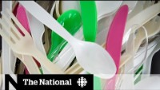
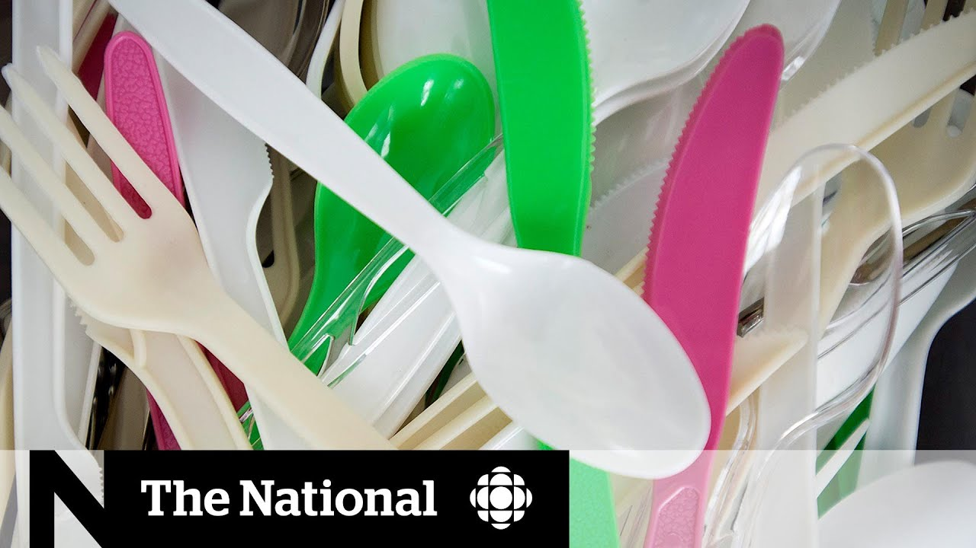
Notes:
Ottawa unveils single-use plastic ban despite increased use during pandemic
https://youtu.be/lCmO3MKzOFM

Slide 19

CANADA 2022 PLASTICS BAN
To Be Banned: – Checkout bags – Stir sticks – Beverage six-pack rings – Cutlery – Straws – Food packaging made from plastics that are difficult to recycle
The below list is not covered yet: – Garbage bags – Milk bags – Snack food wrappers – Disposable personal care items
– Disposable personal care packaging – Beverage containers and lids – Contact lenses and packaging – Cigarette filters – Items used in medical facilities – Personal protective equipment
Photo by Pixabay
Notes:
CANADA 2022 PLASTIC BAN
To Be Banned: – Checkout bags – Stir sticks – Beverage six-pack rings – Cutlery – Straws – Food packaging made from plastics that are difficult to recycle
The below list is not covered yet: – Garbage bags – Milk bags – Snack food wrappers – Disposable personal care items and their packaging – Beverage containers and lids – Contact lenses and packaging – Cigarette filters – Items used in medical facilities – Personal protective equipment

Slide 20
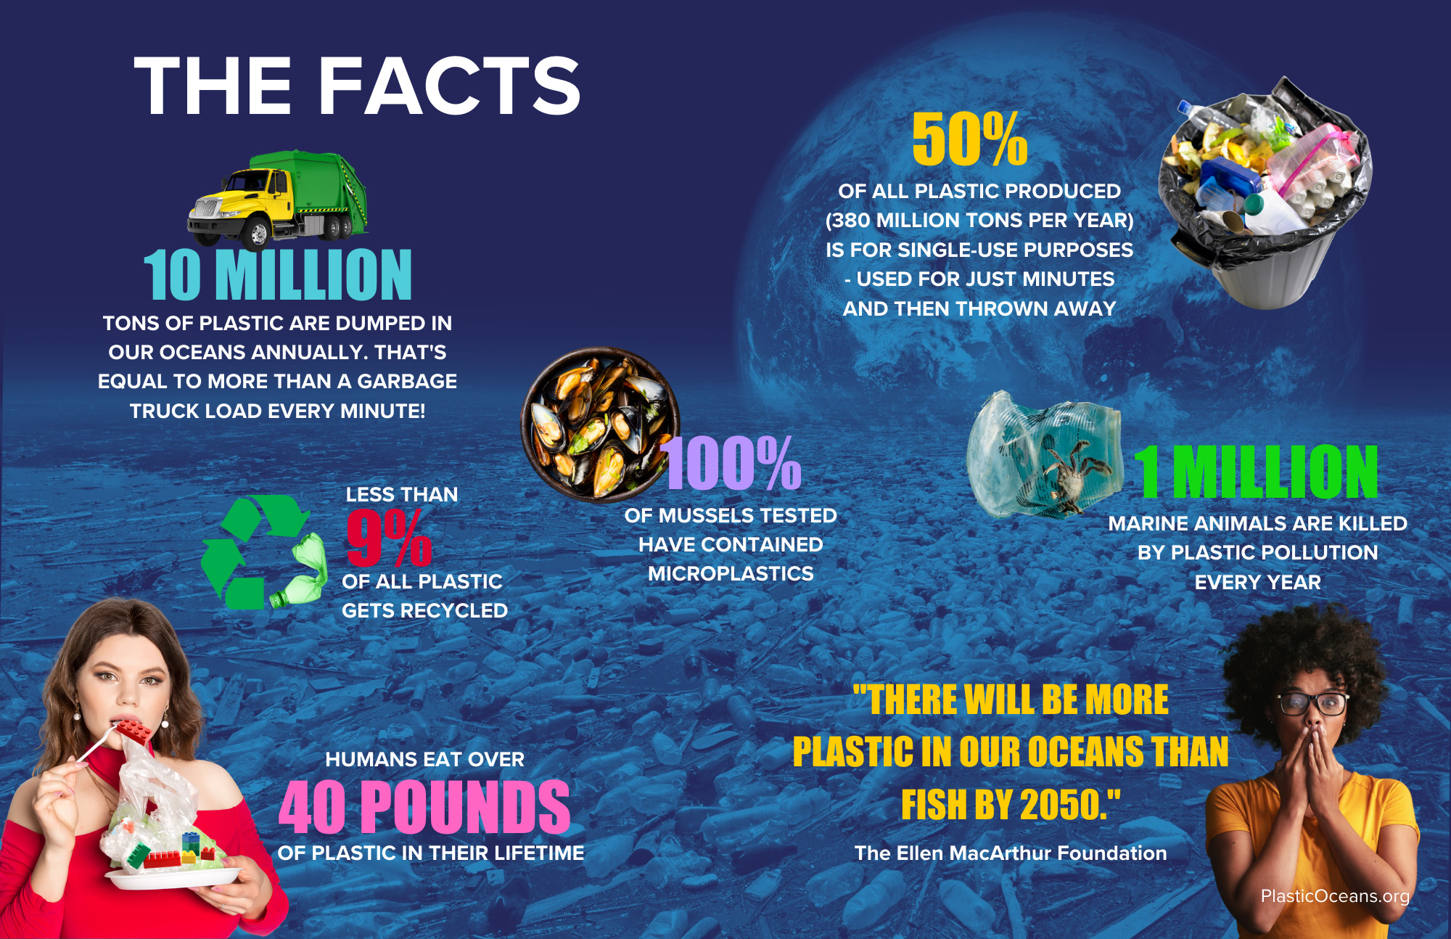
Graphic from - plasticoceans.org/the-facts/
Notes:
Some Facts…
https://plasticoceans.org/the-facts/
The proliferation of plastic products in the last several decades has been extraordinary. Quite simply, humans are addicted to this nearly indestructible material. We are producing over 380 million tons of plastic every year, and some reports indicate that up to 50% of that is for single-use purposes – utilized for just a few moments, but on the planet for at least several hundred years. It’s estimated that more than 10 million tons of plastic is dumped into our oceans every year.

Slide 21
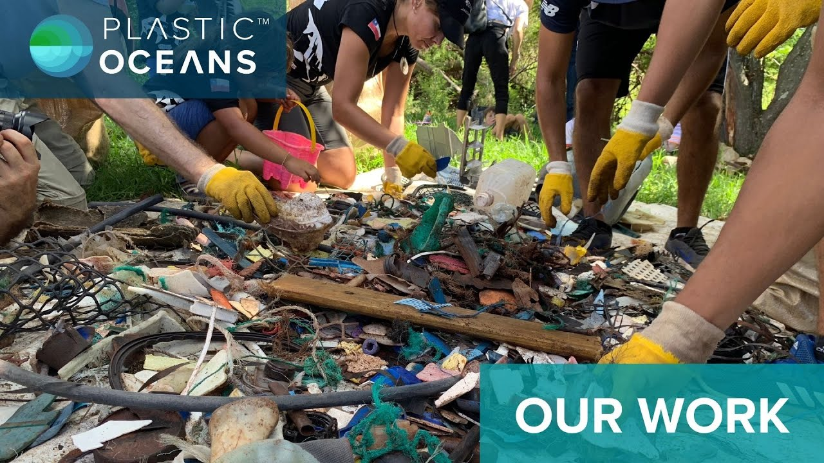

What can be done?
Notes:
What can be done?
https://youtu.be/4-T6AV00t3M
Plastic Oceans International is nonprofit organization working to end plastic pollution and to foster sustainable communities worldwide. We operate with the belief that we can and must act at the local level in order to inspire and create change in consumer behaviour, corporate practices and government policy. Through projects in education, advocacy, activism, science and filmmaking, we're engaging audiences and globalizing local actions to help create a healthier and more equitable planet for all.

Slide 22

BREAK
Photo by Chevanon Photography from Pexels
Notes:
15 Minute Break

Slide 23
THE PERENNIAL PROBLEM OF PLASTIC!
Photo by Nick Fewings on Unsplash
Notes:
THE PERENNIAL PROBLEM OF PLASTIC!
What are the issues surrounding the problem?

Slide 24
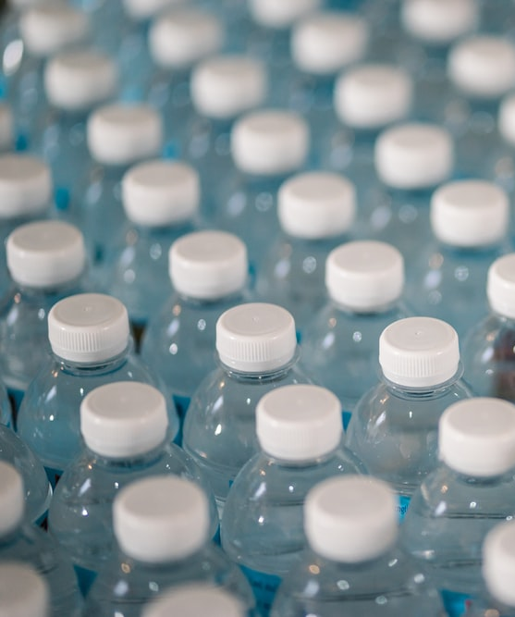
HISTORICAL CONTEXT
Identifying the historical origins of social problems tells us the context within which a social problem has developed.
For example, before thinking about Plastic waste it’s important to understand how we became so reliant on plastic in the first place?
How has bottled water and that industry contributed to the problem?
How has the oil industry turned to and control the production of plastics
What are the ideologies behind bottled water?
Photo by Jonathan Chng on Unsplash
Notes:
Identifying the historical origins of social problems tells us the context within which a social problem has developed.
For example, before thinking about Plastic waste it’s important to understand how we became so reliant on plastic I the first place.
How has bottled water and that industry contributed to the problem?
What are the ideologies behind bottled water?

Slide 25
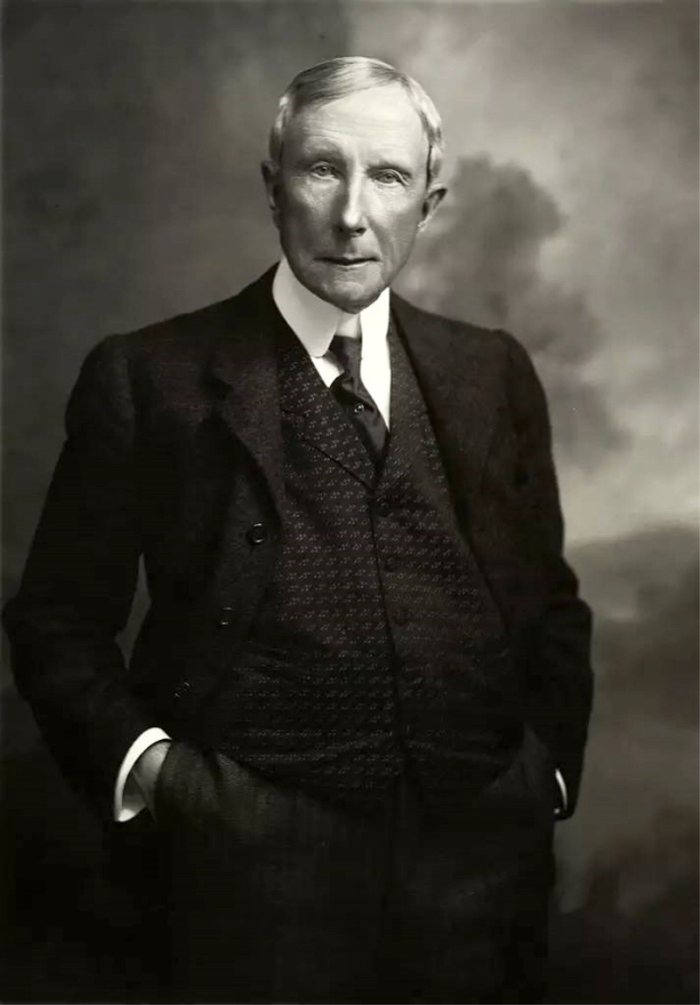
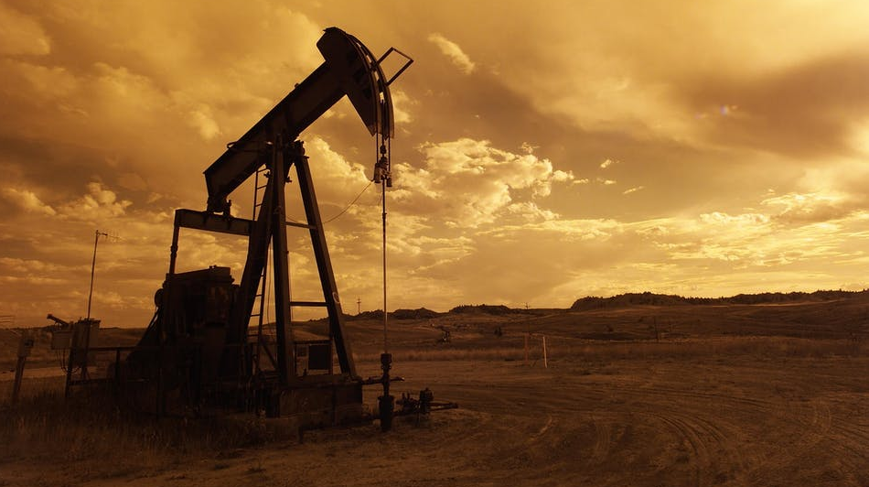
HISTORICAL CONTEXT
Controlled 90% of the
North American Oil Supply!
Photo John D Rockefeller SR By - Oscar White Iasc Culture Public Domain
Notes:
Identifying the historical origins of Today, the biggest of these companies form the core of the U.S. oil industry:
Looking at the oil Industry
One man and his family own close to 90 percent of the entire industry.
The Rockefeller Family
He hired substitute soldiers to avoid Civil War combat.
His father was a con artist and a bigamist
He lived a long life and collected 5$ Million from his Insurance Company
Created the Oil Industry, Petrochemical Industry and Medical Industry
Rockefeller saw the ability to monopolize the oil, chemical and the medical industries at the same time!
Donated more than $500 million to various philanthropic causes to control those industries
The best thing about petrochemicals was that everything could be patented and sold for high profits.
America spends 15% of its GDP on healthcare, which should be really called “sick care.” It is focused not on cure, but only on symptoms, thus creating repeat customers. There is no cure for cancer, diabetes, autism, asthma, or even flu. As for cancer, the American Cancer Society was founded by none other than Rockefeller in 1913.

Slide 26
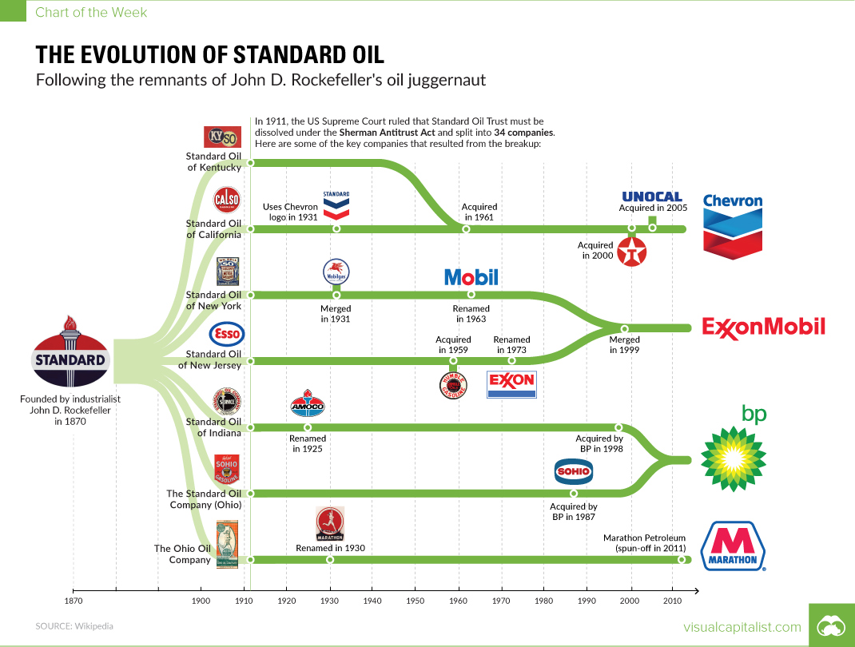
Notes:
The Evolution of Standard Oil
Rockefeller’s juggernaut was split into 34 companies
Today, the biggest of these companies form the core of the U.S. oil industry:

Slide 27
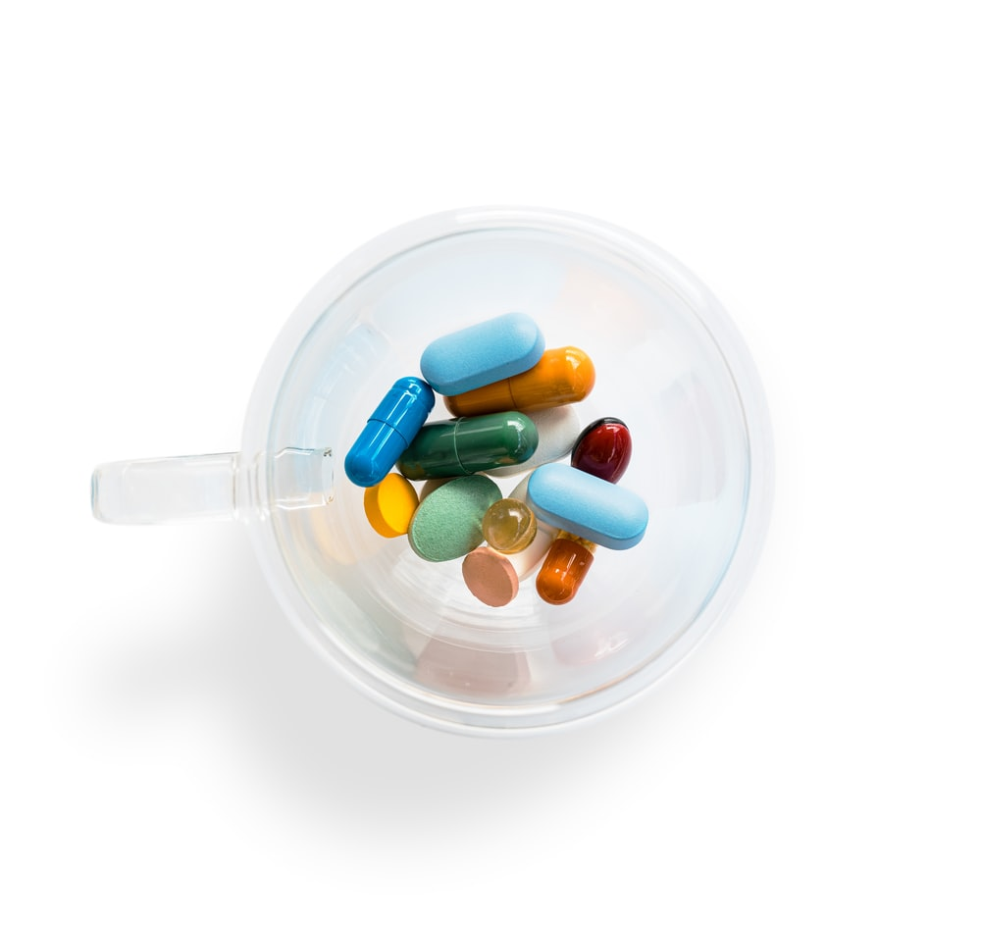
CREATORS OF WESTERN MEDICINE
Natural and herbal medicines were very popular in America during the early 1900s.
a variety of doctors and healing modalities in America.
one half the medical colleges and doctors in America were practicing holistic medicine
Rockefeller used his vast oil money to purchase part of the German pharmaceutical company I.G. Farben called Bayer today
Rockefeller, hired a contractor named Abraham Flexner to submit a report to Congress in 1910
Based on the report, congress acted upon the Flexner’s recommendations and changed laws related to medical practice.
The Hopkins Circle was created to control and perpetuate the ideology of this industry
HISTORICAL CONTEXT
https://meridianhealthclinic.com/how-rockefeller-created-the-business-of-western-medicine/
https://www.ncbi.nlm.nih.gov/pmc/articles/PMC3178858/
Photo by Adam Nieścioruk on Unsplash
Notes:
Natural and herbal medicines were very popular in America during the early 1900s.
a variety of doctors and healing modalities in America.
one half the medical colleges and doctors in America were practicing holistic medicine
Rockefeller used his vast oil money to purchase part of the German pharmaceutical company I.G. Farben called Bayer today
By the way IG Farben were responsible for Auschwitz which was the largest mass extermination factory in human history.
Rockefeller, hired a contractor named Abraham Flexner to submit a report to Congress in 1910
Based on the report, congress acted upon the Flexner’s recommendations and changed laws related to medical practice.
The Hopkins Circle was created to control and perpetuate the ideology of this industry
https://meridianhealthclinic.com/how-rockefeller-created-the-business-of-western-medicine/
https://www.ncbi.nlm.nih.gov/pmc/articles/PMC3178858/

Slide 28
Individuals & Community PERCEPTION
For most of us, how we perceive the problem of plastics in society and recycling is shaped by dominant discourses in the media and popular culture bought by those with controlling interests.
In these discourses, there are three main causes of the problem
failure of public institutions (i.e. allowing use of plastics, pressure from corporations for plastic increase production for profit ),
failure of public policy (government for not banning and or controlling),
failure of the individual (too lazy to recycle, not properly understanding the issues)
Photo by Jonathan Chng on Unsplash
Notes:
For most of us, how we perceive the problem of plastics in society and recycling is shaped by dominant discourses in the media and popular culture.
In these discourses, there are three main causes of the problem
failure of public institutions (i.e. allowing use of plastics, pressure from corporations for plastic increase production for profit ),
failure of public policy (government for not banning and or controlling),
failure of the individual (too lazy to recycle, not properly understanding the issues)

Slide 29
DOMINANT IDEOLOGY & DISCOURSE
AS IT RELATES TO SOCIAL PROBLEM
VIEW OF THE PROBLEM
INDIVIDUAL PROBLEM
INSTITUTIONAL PROBLEM
SYSTEMIC PROBLEM
IDEOLOGY
DOMINANT DISCOURSES
ASSUMPTIONS
INSTITUTIONAL NORMS AND PRACTICES
Notes:
Neoconservative – Individual Problem • Does not acknowledge that the problem is built into capitalism and corporate greed • Does not consider privilege, power, societal needs and
Neoliberal – Institutional Problem
• Acknowledges structural flaws within the system but will not change the system • Supports educational reforms
Social Democratic – Systemic/Structural Problem
• Seeks to reform capitalism system and pushes for more equitable distribution of economic resources in society
Democratic Socialist – Systemic/Structural Problem
• Long-term goal is a socialist society where there is democratic decision making about economic policies and political structures
Decolonizing – Systemic/Structural Problem
• Capitalism is destructive and oppressive. It must be dismantled

Slide 30
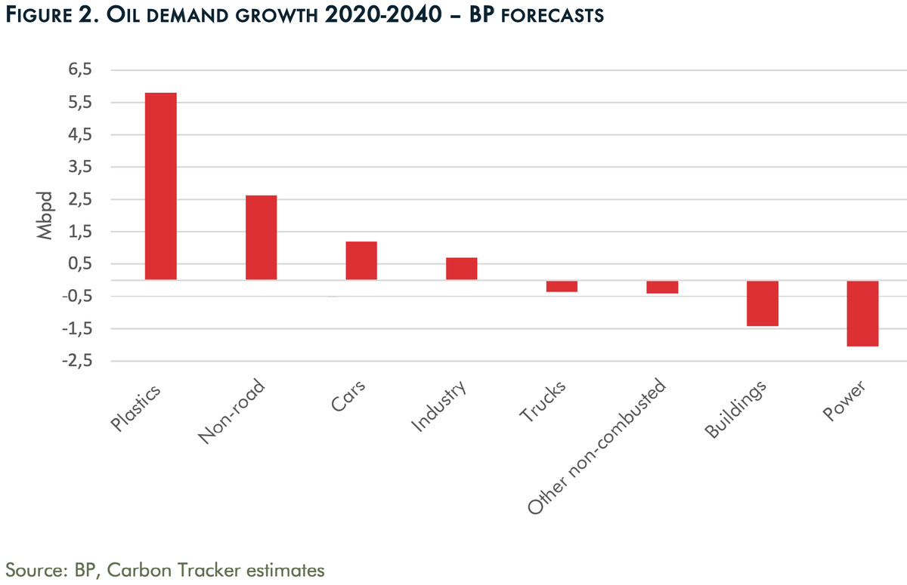
Institutional Perpetuation
Plastics are supposed to drive most oil demand growth
Woven into the fabric of our society and our everyday needs.
Corporations driven by how to continually make money rather that the greater good of people and or the environment.
Capitalism and colonialism drive decision making at corporate and governmental policy and governance.
https://www.vox.com/energy-and-environment/21419505/oil-gas-price-plastics-peak-climate-change
Archive Photos/Stringer/Getty Images - CC BY-SA 4.0
Notes:
Woven into the fabric of our society and our everyday needs.
Corporations driven by how to continually make money rather that the greater good of people and or the environment.
Capitalism and colonialism drive decision making at corporate and governmental policy and governance.
https://www.vox.com/energy-and-environment/21419505/oil-gas-price-plastics-peak-climate-change

Slide 31
BREAK
Photo by Chevanon Photography from Pexels
Notes:
15 Minute Break

Slide 32
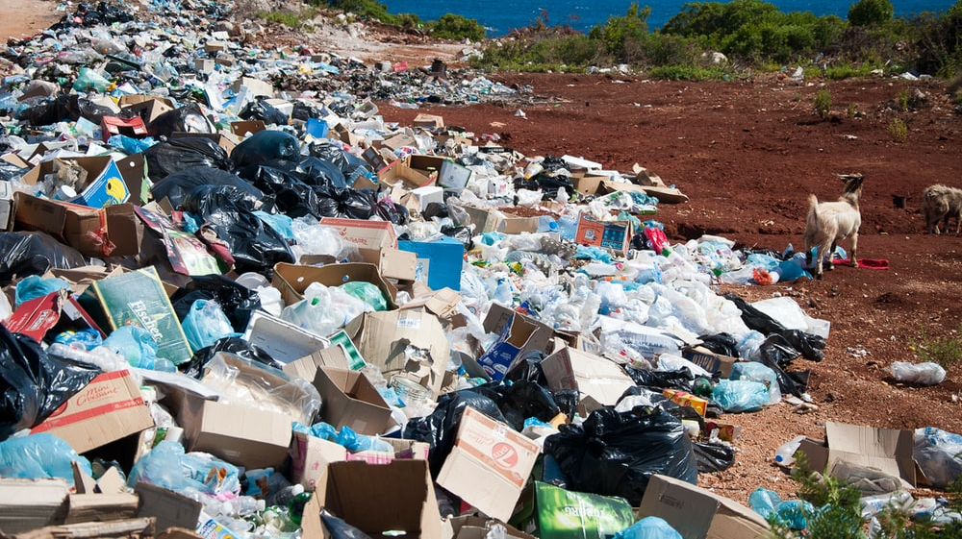
BREAK OUT SESSION
Photo by Antoine GIRET on Unsplash

Slide 33
QUESTIONS
Where/how/why/when did the problem originate?
How has the social problem been challenged historically and by whom?
How has the social problem evolved over time? Have there been changes in laws, norms, practices, & policies that affected it?
Has it been influenced by societal upheavals? Reforms? Revolution?
Why does the problem persist? How is hegemony achieved?
How have powerful groups prevented the social problem from being addressed? Have they made superficial changes that allow them to hold onto power? Or have they used overt institutional power such as the courts, military, or police forces?
Photo by Jonathan Chng on Unsplash
Notes:
Where/how/why/when did the problem originate?
How has the social problem been challenged historically and by whom?
How has the social problem evolved over time? Have there been changes in laws, norms, practices, and policies that affected it?
Has it been influenced by societal upheavals? Reforms? Revolution?
Why does the problem persist? How is hegemony achieved?
How have powerful groups prevented the social problem from being addressed? Have they made superficial changes that allow them to hold onto power? Or have they used overt institutional power such as the courts, military, or police forces?

Slide 34

RESPONSE TO SOCIAL PROBLEMS
Based on these factors, some individuals and communities choose to engage in social action to address the problem.
Others ignore it and hope it goes away on its own.
And yet others continue with harmful attitudes, behaviours, and practices because they just don’t see it as a problem at all and they will NOT change their mind!
Photo by Lara Jameson – Pexels.com
Notes:
Based on these factors, some individuals and communities choose to engage in social action to address the problem.
Others ignore it and hope it goes away on its own.
And yet others don’t see it as a problem at all and continue with harmful attitudes, behaviours, and practices.

Slide 35
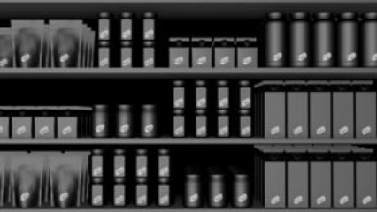
Social ACTION ON PLASTICS
https://aplasticplanet.com/single-goal/
Notes:
Social Action - Solutions
A Plastic Free Isle
Reduce use – Reduce plastic
https://vimeo.com/340290971
https://aplasticplanet.com/single-goal/

Slide 36
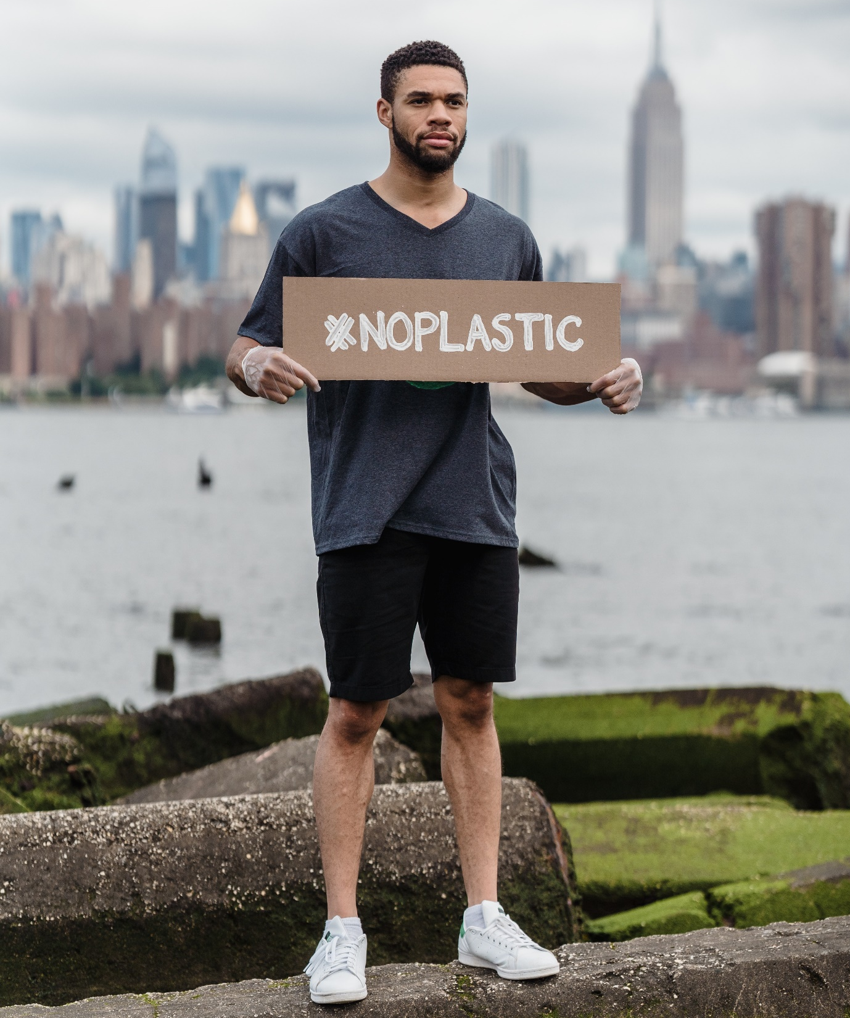
SUMMARY
By engaging in social analysis, we can find the root causes of social problems.
This allows us to evaluate strategies to address them, change our attitudes or behaviours, and take social action.
What action can be taken by whom to bring about long-lasting change?
Government, Individual, Corporation, Ideology…
Photo by Lara Jameson – Pexels.com
Notes:
By engaging in social analysis, we are able to find the root causes of social problems.
This allows us to evaluate strategies to address them, change our attitudes or behaviours, and take social action

Slide 37

QUESTIONS
Photo by Pixabay from Pexels
Notes:
QUESTIONS

